Slide 1

Mobile Application Development
Welcome
Class: BS(CS)-VII
Sukkur IBA University – Kandhkot Campus
Week - 04
Lecture – 08
Your Facilitator, Adil Khan

Slide 2
Common Widgets/Controls in Android

Slide 3
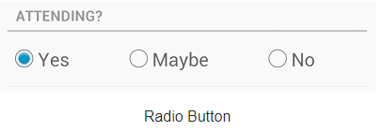
RadioButton
A RadioButton has two states: either checked or unchecked.This allows the user to select one option from a set.
A RadioGroup class is used to use radio buttons.
If we check one radio button that belongs to a radio group, it automatically unchecks any previously checked radio button within the same group.

Slide 4
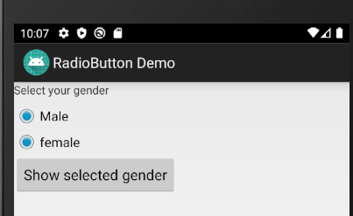
RadioButton
If we do not use the RadioGroup class, then RadioButton will not work properly i.e., more than one buttons can be selected

Slide 5
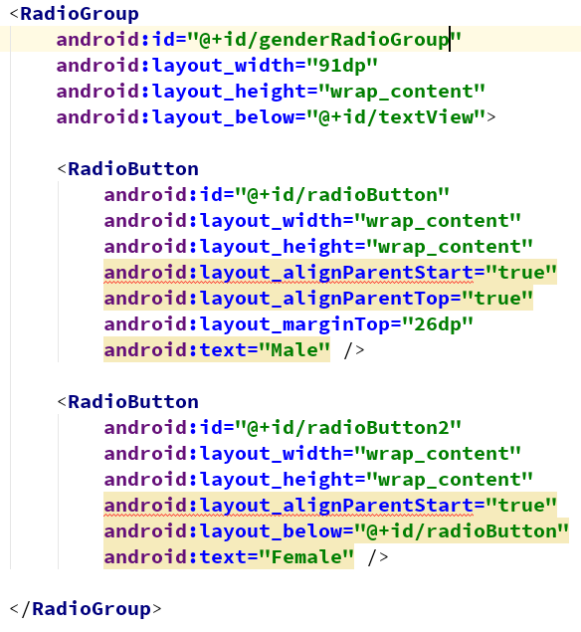
RadioButton

Slide 6
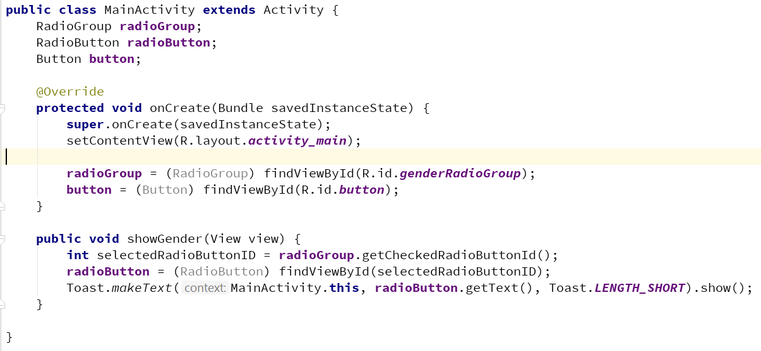
RadioButton

Slide 7
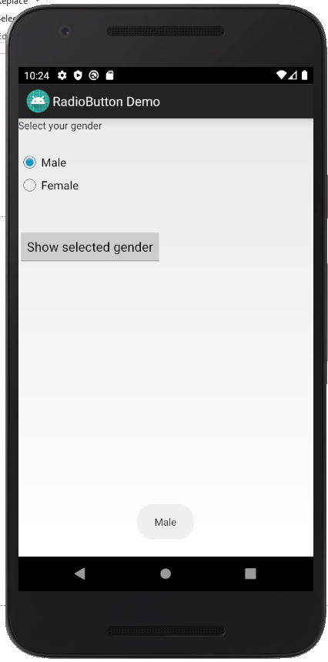

RadioButton

Slide 8
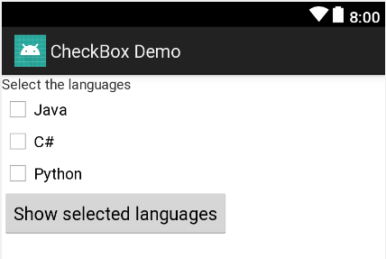
CheckBox
A CheckBox is an on/off switch that can be toggled by the user. You should use check-boxes when presenting users with a group of selectable options that are not mutually exclusive.

Slide 9
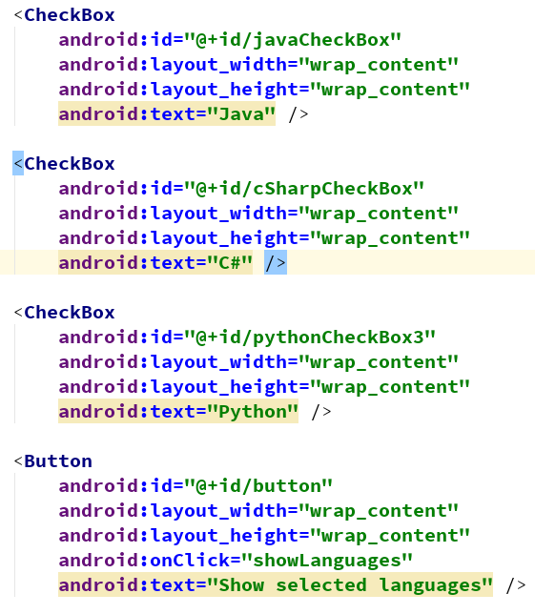
CheckBox

Slide 10
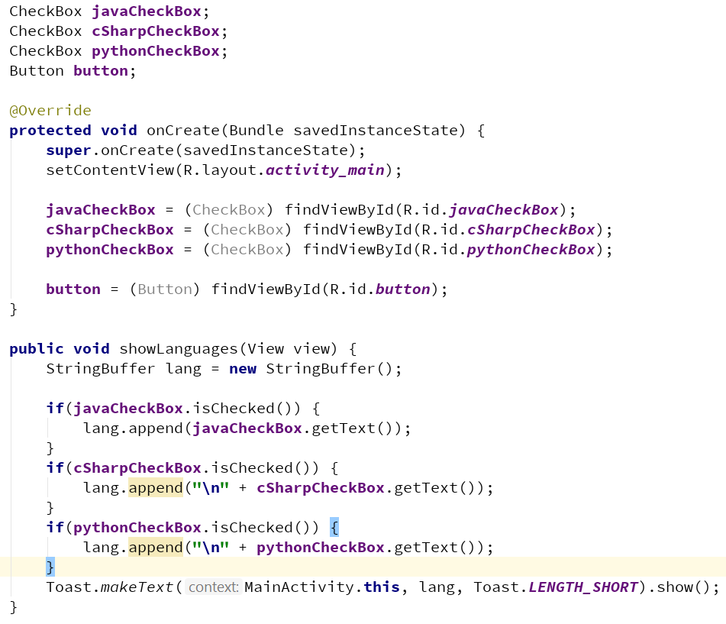
CheckBox

Slide 11
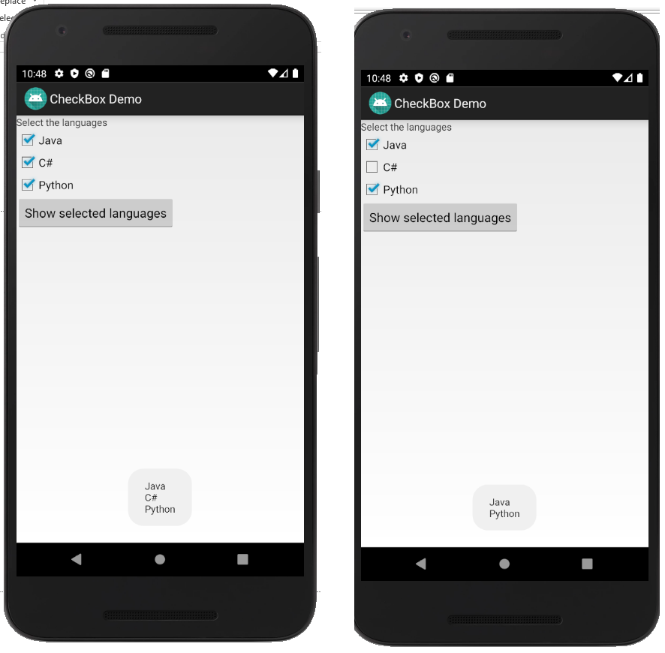
CheckBox

Slide 12
Thank you!
Any Questions???

